Slide 1
The Seal Breaker
Revelation 5
Lewis Winkler
Crossroads International Church • BibleStudyDownloads.org

Slide 2
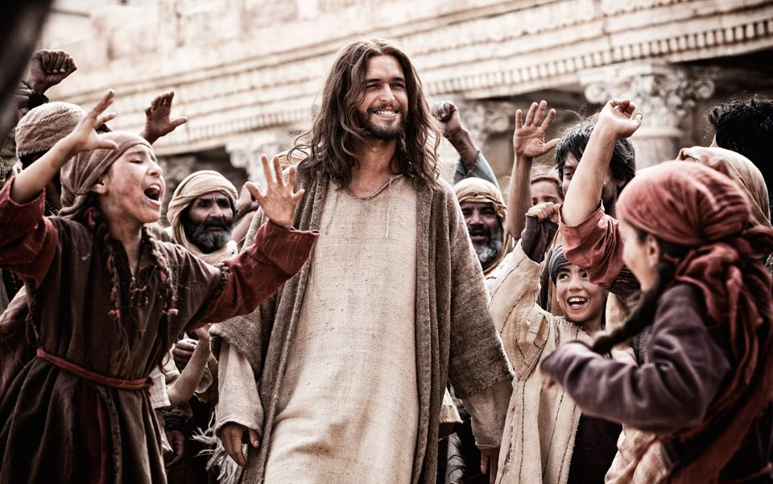
What’s the big deal about Jesus?

Slide 3
Revelation
Sovereignty of Christ in Future Victory
Sovereignty in His Person |  |  | Sovereignty over Churches | Sovereignty in End-Time Events
Chapter 1 |  |  | Chapters 2–3 | Chapters 4–22
"What you have seen" (1:19a) |  |  | "What is now" (1:19b) | "What will take place later" (1:19c)
Past |  |  | Present | Future
Christ Unveiled |  |  | Churches Unveiled | Consummation Unveiled
God on Earth |  |  | God's Ambassadors on Earth | Hell on Earth to Heaven on Earth
The Judge |  |  | The Assignments | The Judgments & Rewards
Subject 1:1-3 | Worship of Trinity 1:4-8 | Glorified Christ 1:9-20 | Seven Churches of Asia: Ephesus Smyrna Pergamum Thyatira Sardis Philadelphia Laodicea | Tribulation 4:1–19:10 | Second Coming 19:11-21 | Millennium 20 | Eternal State 21:1–22:5 | Closing: Imminency 22:6-21
AD 95

Slide 4
Who is worthy to break the seal (5:1-4)?

Slide 5
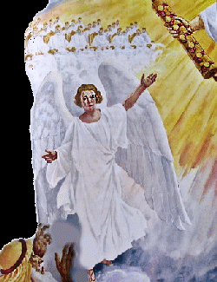
Who is worthy to break the seal (5:1-4)?

Slide 6
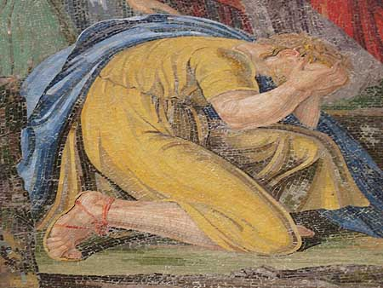
Who is worthy to break the seal (5:1-4)?
No one!

Slide 7
Some Food for Thought
When, if ever, was the last time you desperately longed to open the scriptures and hear from God?

Slide 8
Jesus is worthy to break the seal (5:5-10)!
Because of Who He Is (5-8):
He is the Lion of the tribe of Judah (5).

Slide 10
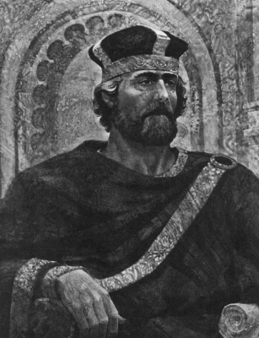
Jesus is worthy to break the seal (5:5-10)!
Because of Who He Is (5-8):
He is the Root of David (5).

Slide 11
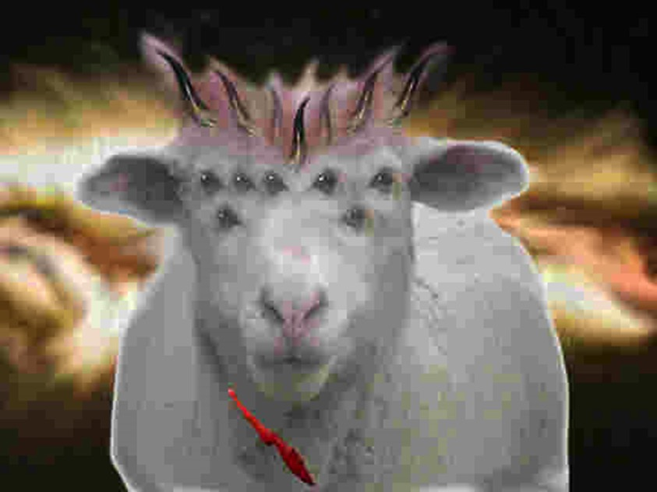
Jesus is worthy to break the seal (5:5-10)!
Because of Who He Is (5-8):
He is the Lamb who was slain (6-8).

Slide 12
Jesus is worthy to break the seal (5:5-10)!
Because of What He Has Done (9-10):
He ransomed people from every tribe, tongue, and nation (9).

Slide 13
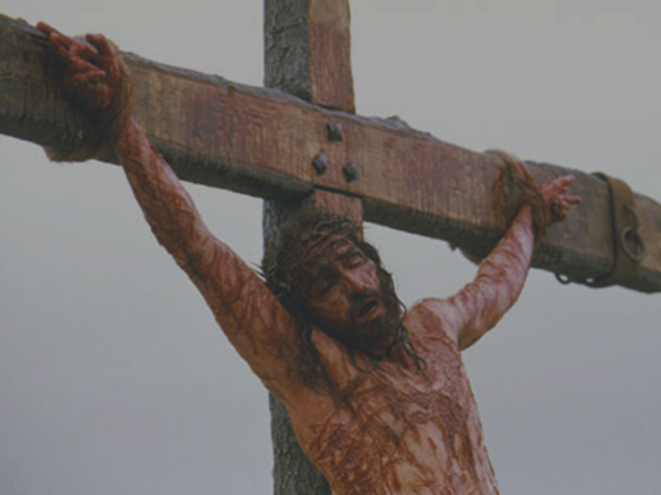
For our sake [God] made [Jesus] to be sin who knew no sin, so that in him we might become the righteousness of God.
—2 Corinthians 5:21

Slide 14
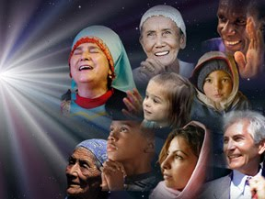
Jesus is worthy to break the seal (5:5-10)!
Because of What He Has Done (9-10):
He made them a kingdom of priests (10).
"Therefore, we are ambassadors for Christ"
—2 Cor. 5:20

Slide 15
Jesus is worthy to break the seal (5:5-10)!
"It is worth noticing that worship is reserved for God only. That the Lamb is worshipped is evidence of His full divinity."
—Leon Morris

Slide 16
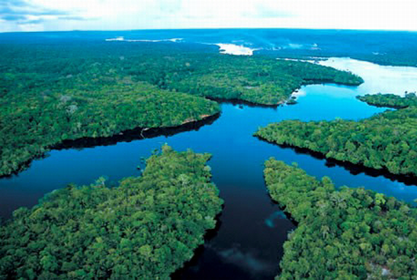
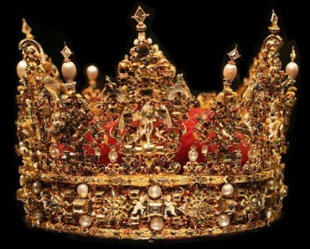
Believers will rule the earth (5:10 NLT).
"And you have caused them to become a Kingdom of priests for our God. And they will reign on the earth."

Slide 17
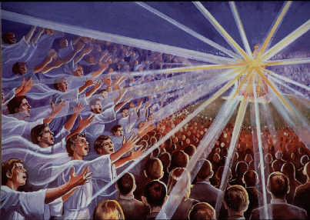
Jesus is worthy of all worship (5:11-14)!

Slide 18
Conclusion and Application

Slide 19
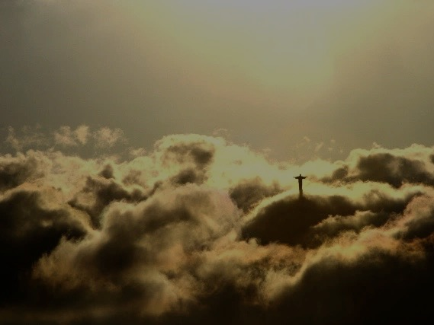
Main Idea:
Jesus is worthy to reveal the future and be worshiped because He is the Divine Messiah and redeemed us from the penalty of sin, making us a kingdom of priests.

Slide 20
Personal Application
Have you truly trusted in Jesus Christ to forgive your sin and bring you into a right relationship with God?
If so, does your life really reflect the fact that you are God’s representative on earth?
Do you regularly worship and give Christ the thanks and honor He rightly deserves?

Slide 21
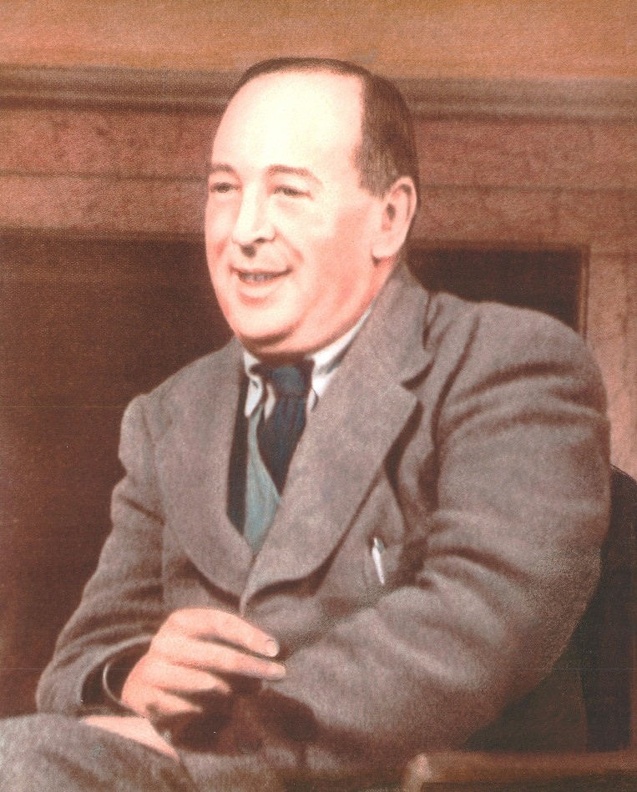
C. S. Lewis’ Story

Slide 22
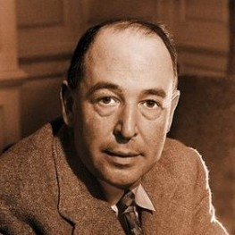
C. S. Lewis’ Story
"If ever a myth had become fact, had been incarnated, it would be just like this. . . . And no person was like the Person depicted; as real, as recognizable, through all that depth of time . . ., yet also numinous, lit by a light from beyond the world, a god. But if a god . . . then not a god, but God. Here and here only in all time the myth must have become fact; the Word, flesh; God, Man."
C. S. Lewis, Surprised by Joy, 136.

Slide 23
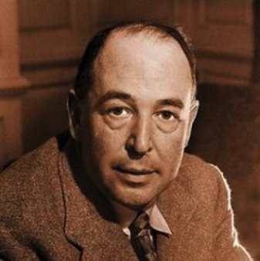
C. S. Lewis’ Story
"I am here trying to prevent anyone saying the really foolish thing that people often say about Him: “I’m ready to accept Jesus as a great moral teacher, but I don’t accept His claim to be God.” That is the one thing we must not say. A man who was merely a man and said the sort of things Jesus said would not be a great moral teacher. He would either be a lunatic—on a level with the man who says he is a poached egg—or else he would be the Devil of Hell. You must make your choice. Either this man was, and is, the Son of God: or else a madman or something worse. You can shut Him up for a fool, you can spit at Him and kill Him as a demon; or you can fall at His feet and call Him Lord and God. But let us not come with any patronising nonsense about His being a great human teacher. He has not left that open to us. He did not intend to."
C. S. Lewis, Mere Christianity, 55-56

Slide 24
Black

Slide 25
Jesus Wins!
Series on Revelation

Slide 26
NT Sermons link at biblestudydownloads.com
Get this presentation for free!

